Slide 1
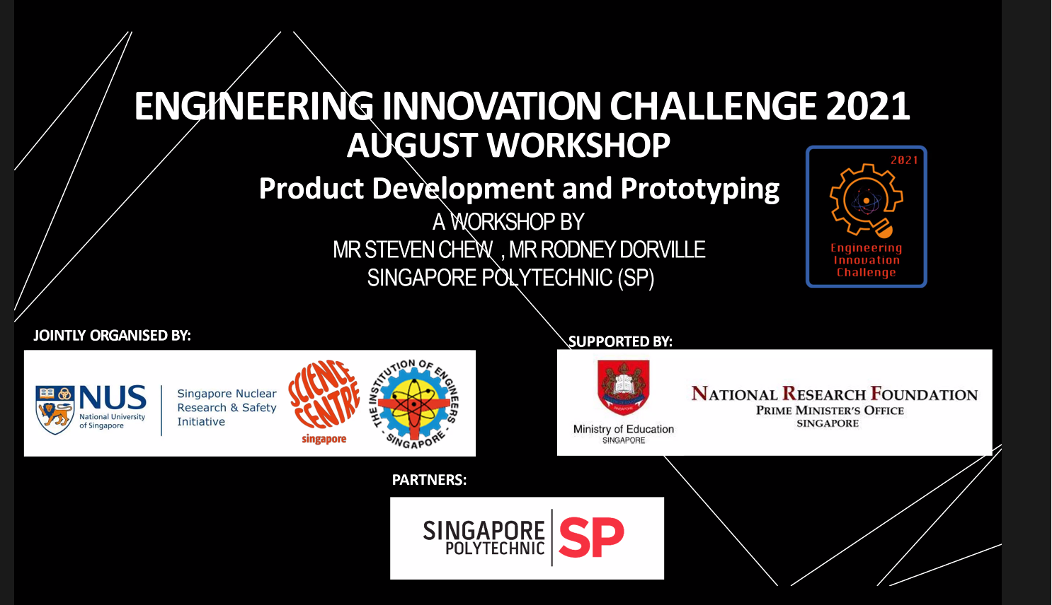
Notes:
Videos to open
Cardboard Prototyping - https://youtu.be/k_9Q-KDSb9o
Cardboard Construction Techniques - https://youtu.be/MpjyOjPj98I
Rian Touag - https://youtu.be/g6xG-5YtesU

Slide 2
Product Development & Prototyping
Rodney Dorville
Fablab Singapore Polytechnic

Slide 3
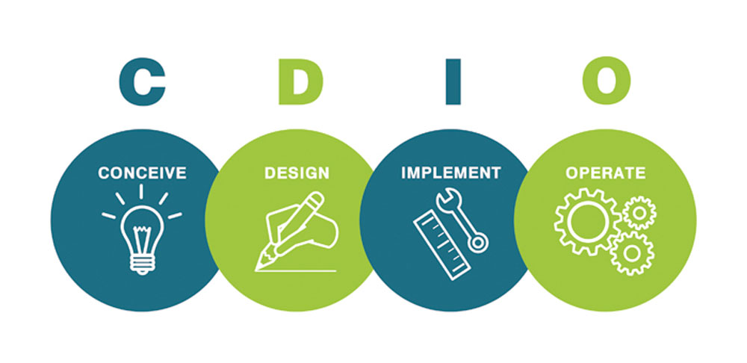
CDIO Process
Notes:
In any process development, you should always consider the CDIO process.
Conceive the idea, method, technology, pathway
Design your product, putting in constraints etc
Implement and make it
Operate and make changes improving the system
For new ideas – usually you don’t have the Time, Resources or Knowledge for a full blown development process
Hence, you prototype

Slide 4
Prototyping
A prototype is an early sample, model, or release of a product built to test a concept or process
A chance to validate whether your idea matches users’ thoughts.
Ref: Wikipedia
Fail faster, Succeed sooner
David Kelley
Ref: Stanford Social Innovation Review
Notes:
Use the CDIO process to create a prototype
It is a working model of how the actual product is going to look, feel and operate.
Leave the aesthetics and niceties to the final outcomes/designer
Let’s make it work!
The faster you fail, the sooner you recover, and get better results
David Kelly – Founder of IDEO (https://ssir.org/articles/entry/fail_faster_succeed_sooner)

Slide 5

Pros & Cons
Advantages
Disadvantages
Get a quick view (overview)
Can try different ideas
Find mistakes early
Switch tracks easily
Develop into a more refined product
Time – needs proper planning
Cost
Resource intensive
Heartache

Slide 6

Prototyping
Quirky: How to make a cardboard prototype (2 min)
Notes:
Quirky shows how to go from an idea to a prototype using cardboard, he also shows the different techniques used in cardboard prototyping

Slide 7
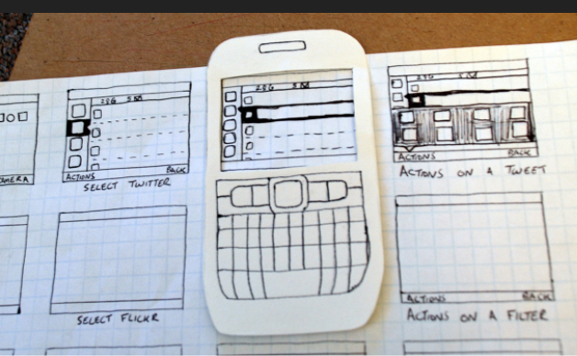
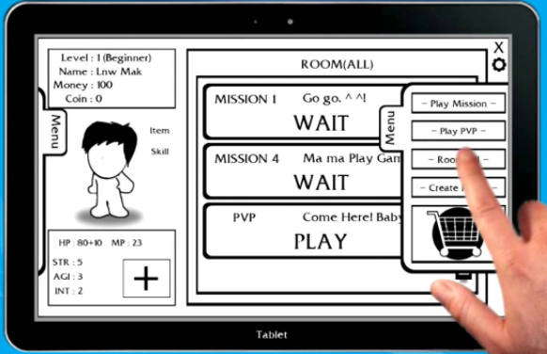
Paper prototyping
The simplest method.
Easy, quick, cheap, available everywhere, recyclable.
Great for a first effort.
However,
Not robust
Limited shapes for easy creation

Slide 8
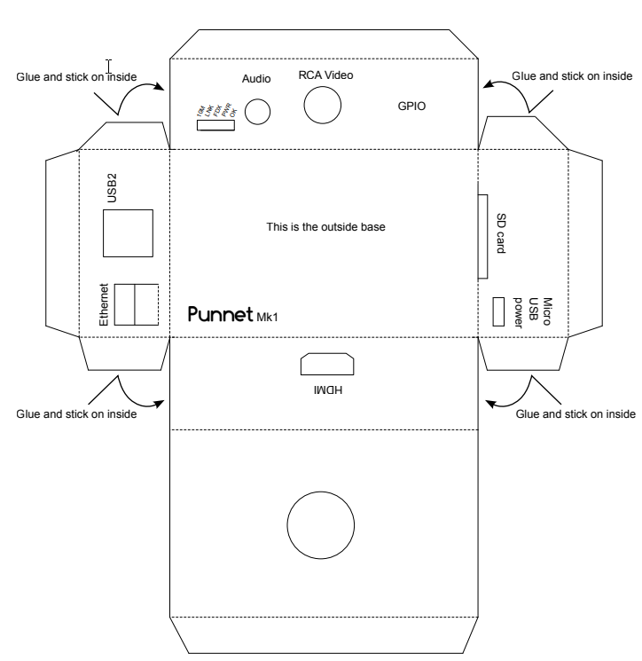
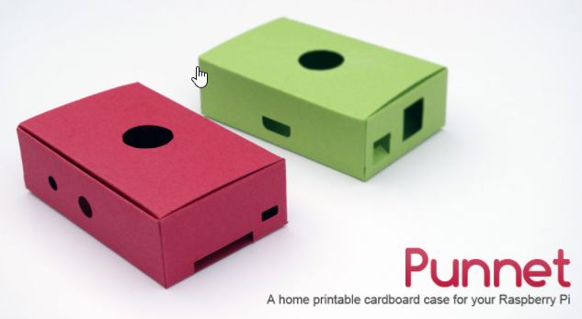
Print & Cut
The Punnet – card case for RPI
Some designs are available on the Internet
Complex designs may need skills and planning
Consider origami methods

Slide 9
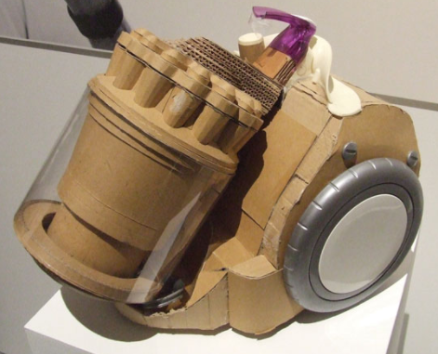
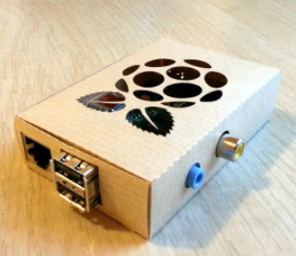
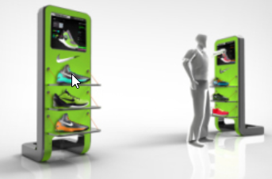
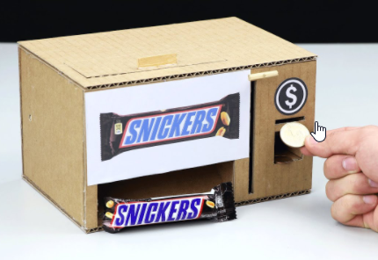
Cardboard Prototyping
Simple & easy mock-ups
100% recyclable
Can be done with a knife and ruler
Digital design
2D drawing or 3D CAD design
Flatbed cutter
Re-sizeable

Slide 10
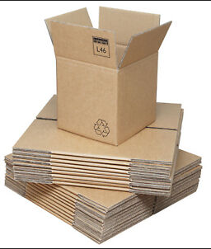
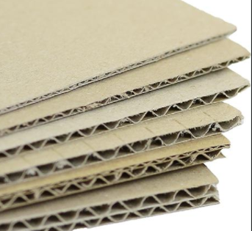
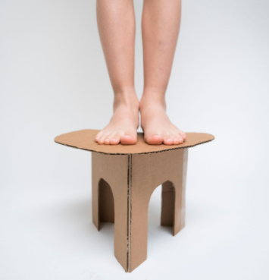
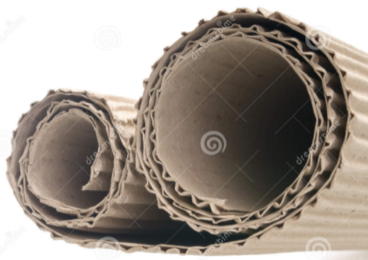
Corrugated Cardboard
Easy to manipulate
Sturdy
Easy to obtain
Recyclable
Almost free
Cheap

Slide 11
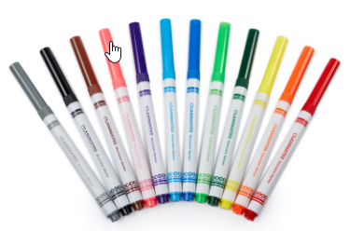
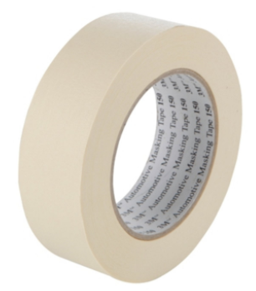
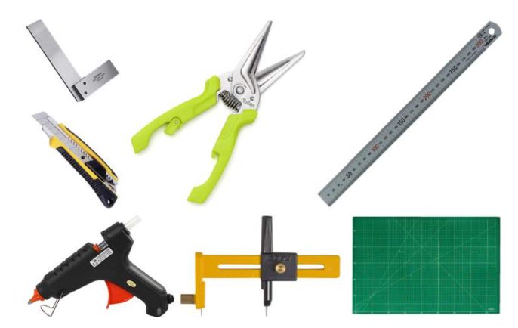
Tools Required
Cutting Mat
Box Cutter
Metal rulers
Sturdy shears / scissors
Hot Glue Gun & glue sticks
Markers, pens, pencils
Masking tape
Machinist square 90º
Circular cutters
Adafruit: Cutting Tools and Techniques

Slide 12
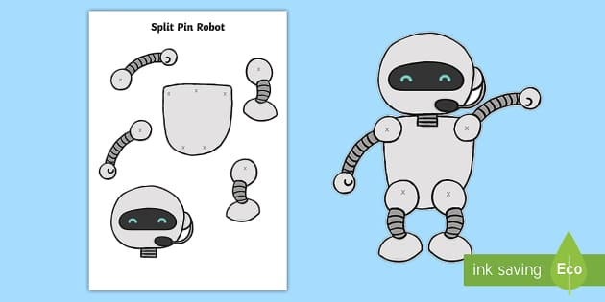
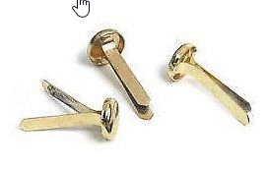
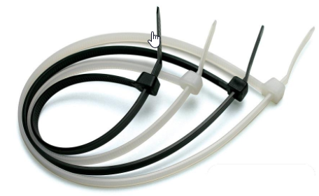
Techniques - Fasteners
Fixtures
Masking Tape
Double-side Tape
White/Paper glue, UHU
Hot-melt glue
Movement
Cable Ties
Joints
Split-pin tacks
Rivets
Notes:
Fixtures – depends on how fast you can work, and how fast the fixture is made
Masking tape – take your time, immediate fixture
Double sided tape – take your time, immediate fixture
White Glue – 30~60 minutes, 4 hours to set, 24 hrs full strength
UHU – 5~10 minutes, 1 hour to set, 4 hours full strength
Hot melt glue – 1 minute, 3~5 minutes to set, 10 minutes full strength
Cable ties are a fast way of joining items with a liberal degree of movement
Split-pin tacks allow 360 degree movement in the fixation plane
Rivets provide are stronger fix, with varying stiffness to the motion

Slide 13
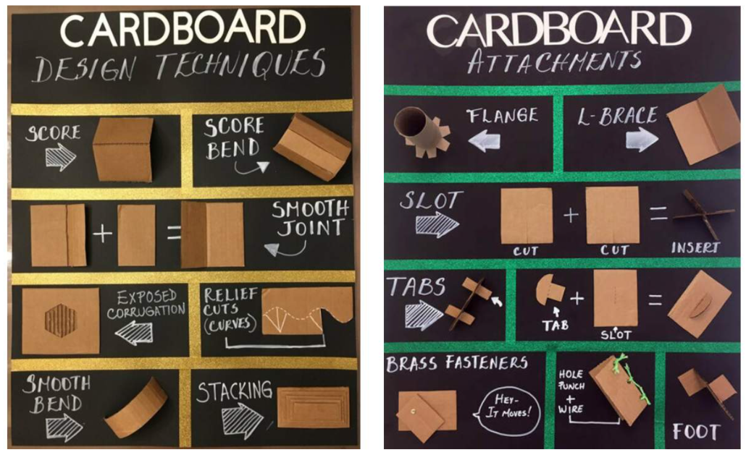
Techniques
Ref: Bay Area Educators Night
Notes:
Bay Area has lots of nice ideas and samples

Slide 14
Construction Techniques
Arianne Schnalzer – Cardboard Construction (6 min)

Slide 15
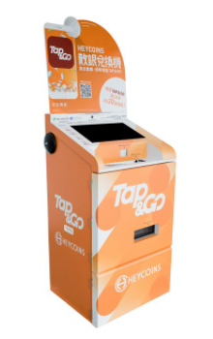
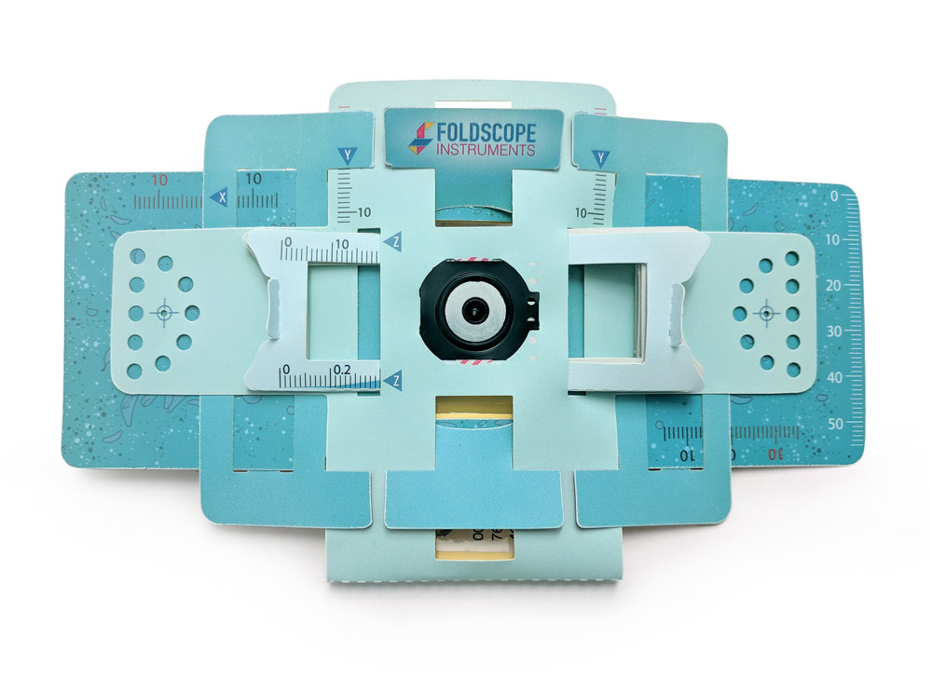
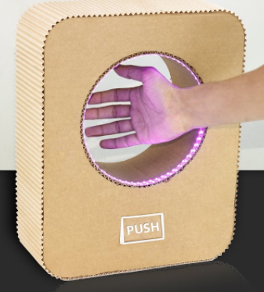
Cardboard Prototypes
Manu Prakash: Frugal Foldscope
UV Sanitizer
Kiosks

Slide 16
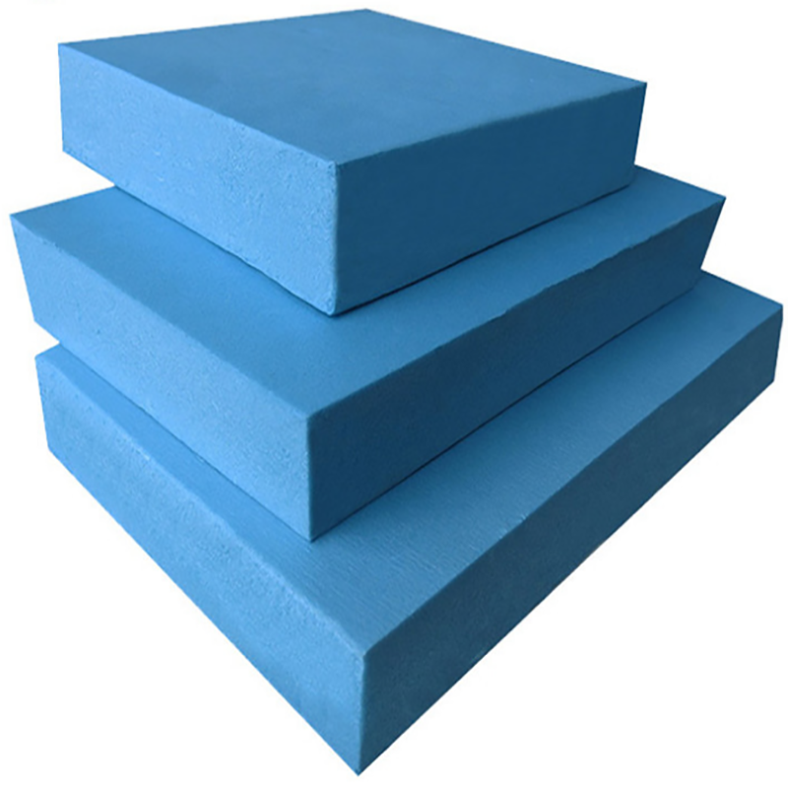
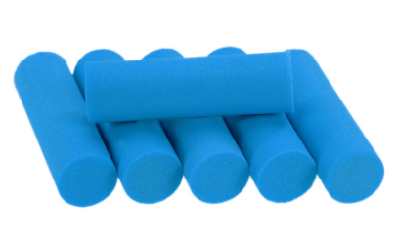
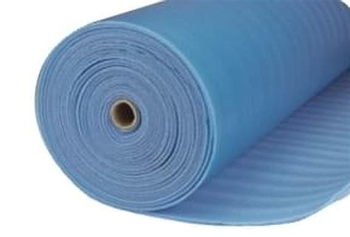
Blue Foam
XPS (Extruded PolyStyrene) foam
Available in blocks or sheets
Good for
Solid modelling
Authentic look and feel
Large models and prototypes
Handling
Manual techniques
Digital Fabrication Machining

Slide 17
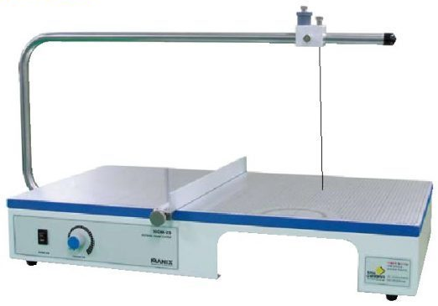
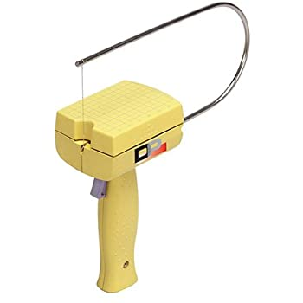
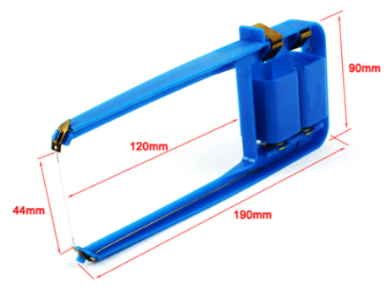
Cutting Blue Foam – Hot Wire
Handheld foam cutters
Table top foam cutters

Slide 18
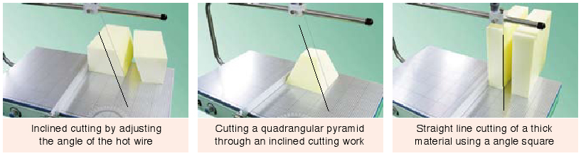
Cutting Foam Shapes
AlfonsoTheTraitor: Cutting circles with a hot wire foam cutter
Quassi’s Bell Tower: How to Make a Circle Jig for your Proxxon Thermcut

Slide 19
Foam Prototypes
Shaping Tools:
Carving knife
Hot Wire
Sandpaper
Rasp & Assorted Files
Heat Gun
Rian Touag: Foam Modelling - How To Make Rapid Prototypes (2 min)
Notes:
Lots of tutorials and videos in the guides column

Slide 20
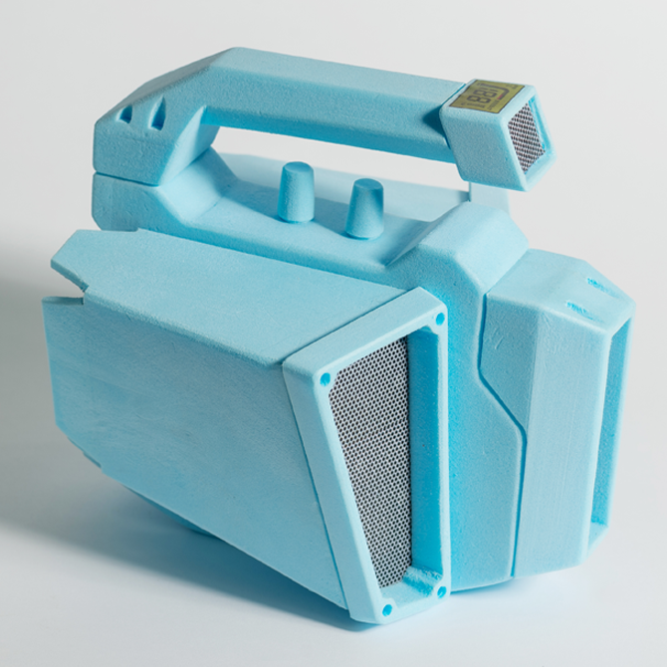
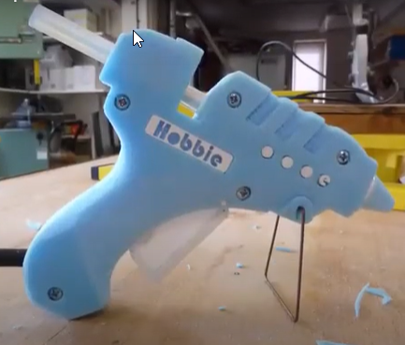
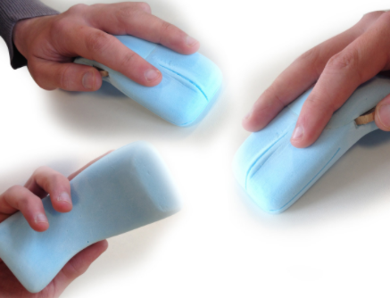
Blue Foam Prototypes
Radio
Hot Glue Gun
Mouse
Foam prototypes add a SOLID touch/feel
Design Sojourn: Re-thinking the hair dryer
Notes:
Blue foam allows a level of solidness.
If coated with a resin/paint/textured can be made to feel like the real product
Good for testing feels and ergonomics: Hair dryer grips: https://s3files.core77.com/blog/images/571176_34481_60264_gbSeIsTzL.jpg
Design Sojourn : Re-thinking the hair dryer (https://designsojourn.com/rethinking-the-hairdryer/)
Ariane Prin : Hair dryer concepts (https://s3files.core77.com/blog/images/571176_34481_60264_gbSeIsTzL.jpg)

Slide 21
Guides:
Cardboard
Adafruit: Cardboard Fundamentals - John Park
Remember to also check out the links at the end of the article
Making Society: Cardbord Shaping Techniques
Foam
Juan Noguera - Blue Foam - Basic Model Making Techniques
Icarus Games - An Introduction to Working With Blue Foam (Styrofoam)XPS
Make: Skill Builder: Styrofoam Sculpting, Surfacing, and Sugru Skinning
CARVING FOAM: How To Carve Polystyrene Projects

Slide 22
Product Development & Prototyping
Rodney Dorville
Fablab Singapore Polytechnic

